Slide 1
Python For Business

Slide 2
Four Circles of R&A using various software
Theory/
Domain/Biz
knowledge
Data, Measures & Stats
Algorithm & Software
Visualization Reporting/ Communication
Methodology

Slide 3

Overview
Introduction to Python Programming
Variables, Data Types, and Data Structures
Conditionals and Loops
Features, Libraries, and Applications of Python Programming
Elementary Problems

Slide 4
Introduction to Python Programming
Python is a powerful, high-level, easy to learn programming language that has rich data-focused libraries.
It is flexible and can be used for a wide range of business applications, including data analysis, web development, machine learning, artificial intelligence, automation, and more.
History: Python was developed by Guido van Rossum in the late eighties and early nineties at the National Research Institute for Mathematics and Computer Science in the Netherlands.

Slide 5
Why Python?
Easy to Learn and Use: Python has a simple syntax that makes it suitable for learning programming as a first language.
Expressive Language: Python allows you to develop more complex software with fewer lines of code.
Efficiency: Python allows businesses to automate repetitive tasks, saving time and increasing efficiency.
Versatility: Python can be used for a wide range of tasks including data analysis, visualization, web scraping, and more.
Community: Python has a large and active community of developers, which ensures constant updates, improvements, and a large pool of resources for learning and troubleshooting.

Slide 6
Applications of Python Programming
Web Development: Django, Pyramid, Flask, etc. are some of the Python frameworks which are used for web development.
Game Development: PySoy (a 3D game engine that supports Python 3), Pygame are Python libraries used for game development.
Machine Learning and Artificial Intelligence: ML and AI are the future of the world. Python has libraries like TensorFlow, PyTorch, Keras for developing AI and ML based applications.

Slide 7
Business applications of Python
Data Analysis: Python can be used to make sense of and derive insights from large sets of data.
Automation: Python scripts can automate many routine and repetitive tasks, improving efficiency.
Web Development: Python's Django and Flask frameworks are powerful tools for web development.
Machine Learning: Python's libraries like scikit-learn, TensorFlow, and Keras can be used to build predictive models for business forecasting.
Web Scraping: Python can be used to collect data from the web for market research and competitor analysis.

Slide 8
Libraries of Python
pandas: This library offers data structures and operations for manipulating numerical tables and time-series data, making it excellent for data analysis tasks.
NumPy: Used for numerical computations, it is especially useful for handling large data arrays.
Matplotlib and Seaborn: These libraries are used for data visualization, allowing businesses to visually interpret complex data.
Scikit-learn: This machine learning library provides a range of supervised and unsupervised learning algorithms.

Slide 9
Variables, Data Types, and Data Structures
Variables: In Python, variables are a storage placeholder for texts and numbers. It must have a name so that you are able to find it again. The variable is always assigned with the equal sign, followed by the value of the variable.
Data Types: Python supports different types of data types like Numbers (int, float, complex), String
Data Structures: Python provides four basic inbuilt data structures - List,series, dataframe, Dictionary, Tuple and Set.

Slide 10
Conditionals and Loops
Conditionals: Python supports the usual logical conditions from mathematics: Equals (==), Not Equals (!=), Less than (<), Less than or equal to (<=), Greater than (>), Greater than or equal to (>=). These conditions can be used in several ways, most commonly in "if statements" and loops.
Loops: Python programming language provides following types of loops - while loop, for loop, and nested loops.

Slide 11

Python Environment
In Python programming, the environment refers to the context in which Python code is executed.
It includes the Python interpreter itself, any libraries or modules you might be using, and any settings or preferences.
There are several popular Python environments that are used for different purposes like:
Anaconda
Jupyter Notebook
Google Colab

Slide 12
Anaconda: This is a free and open-source distribution of the Python and R programming languages for scientific computing. It simplifies package management and deployment. Anaconda comes with a suite of graphical tools called Anaconda Navigator. This includes Jupyter Notebook and Spyder, a Python-specific IDE (Integrated Development Environment).
Jupyter Notebook: This is an open-source web application that allows the creation and sharing of documents that contain live code, equations, visualizations, and narrative text. Jupyter notebooks are great for data cleaning and transformation, numerical simulation, statistical modeling, data visualization, and machine learning. They are widely used in data analysis and scientific research.
Google Colab: Short for Google Colaboratory, Colab is a free cloud service based on Jupyter Notebooks for machine learning education and research. It provides a way for your Python code to be run on Google's servers, meaning you can leverage the power of Google hardware, including GPUs and TPUs, regardless of the power of your own machine.

Slide 13
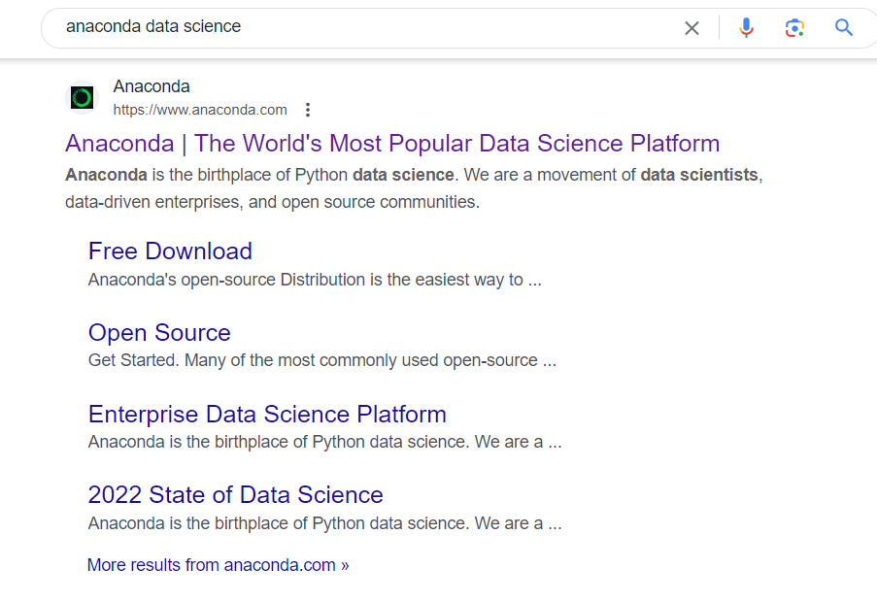
Python Installation and environment setup

Slide 14

Download the .exe file

Slide 15


Slide 16
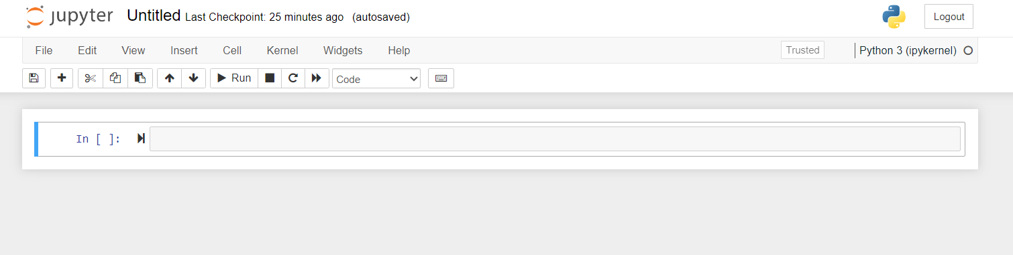

Slide 17
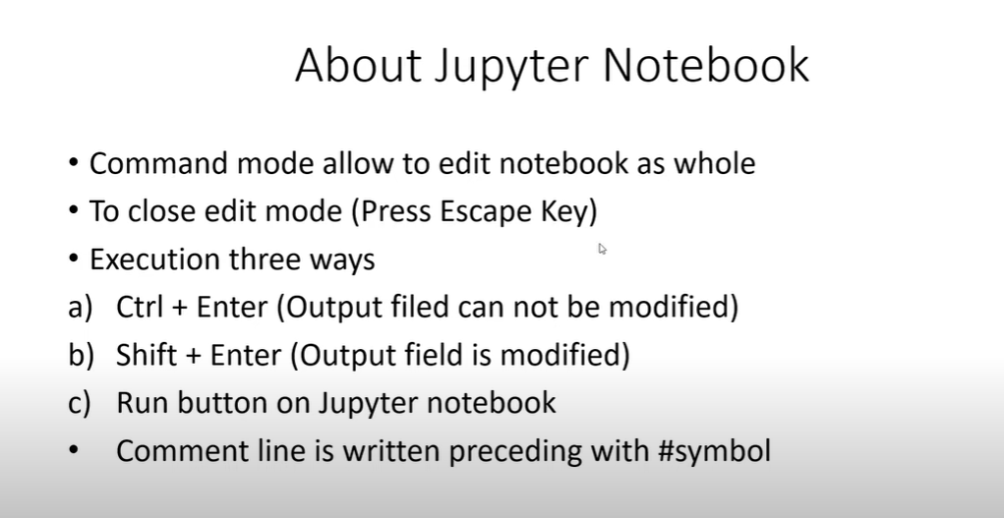

Slide 18
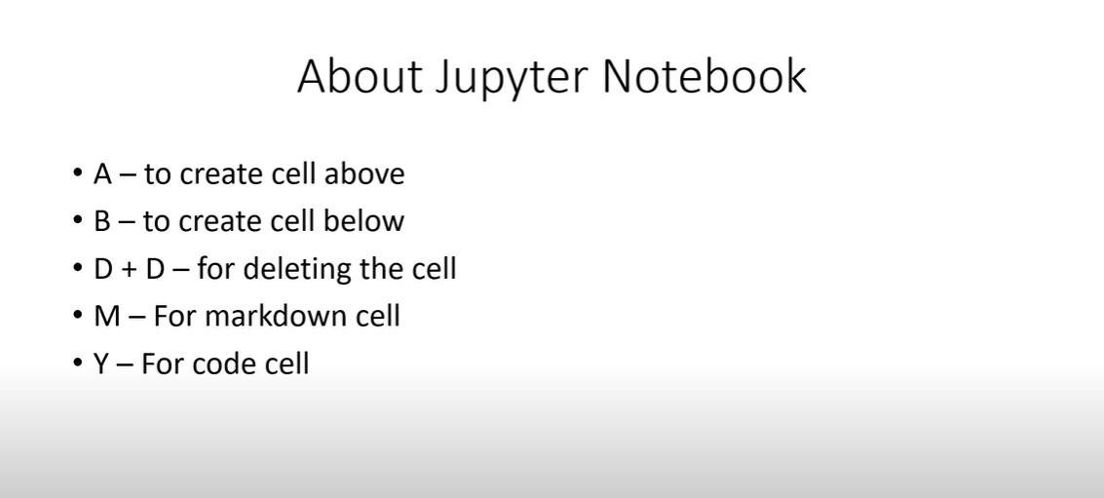

Slide 19
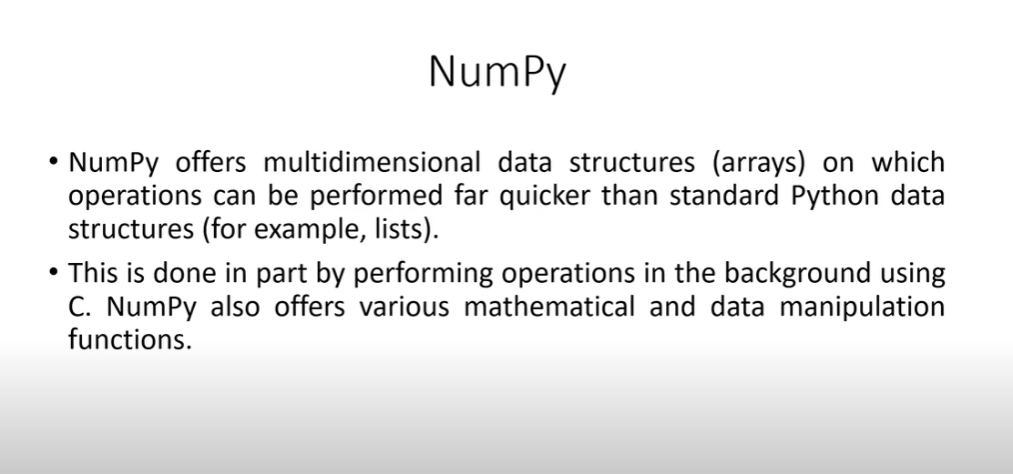
Libraries

Slide 20
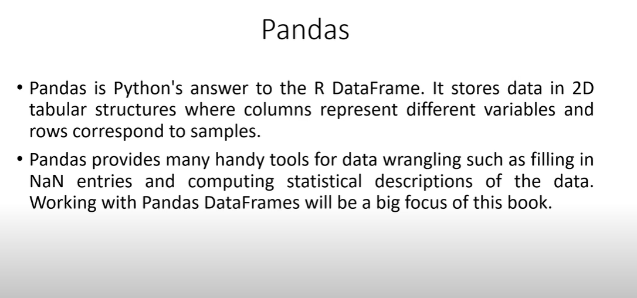

Slide 21
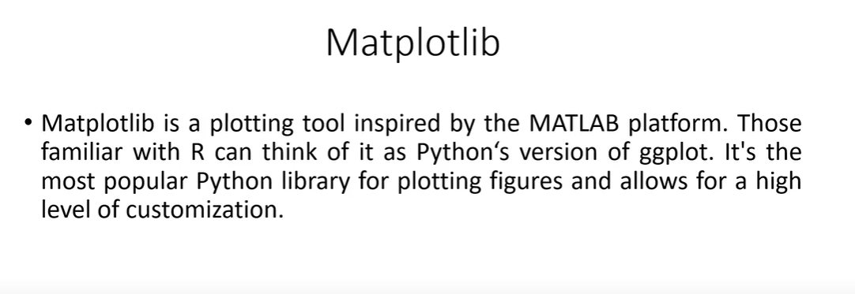

Slide 22
Python Data Types and Variables
Integers: Whole numbers without a decimal point.
Floats:Numbers with a decimal point.
Strings: Sequences of characters.
d) Boolean: Represents true or false values.
10 # integer y =
3.14 # float z =
"Hello" # string a =
True # boolean print(x, y, z, a)

Slide 23
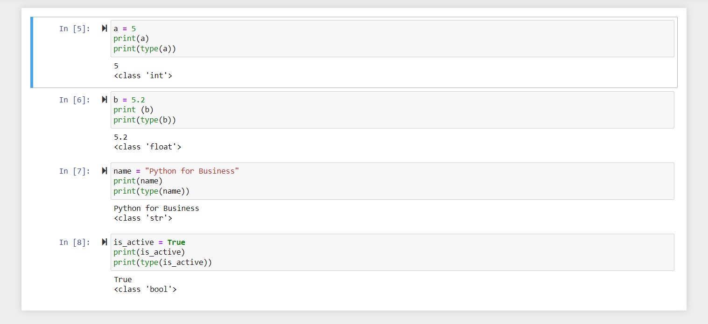
Print Statement : The print() function is used to output data to the console.
print("Hello, Python!")

Slide 24
Variables
Variables are names assigned to hold different values.
Gender= “Male”
Age=20

Slide 25
Basic Operations
Arithmetic Operations: Basic math operations.
x = 10
y = 20
Addition = x + y
Subtraction = x - y
Multiplication = x * y
Division = x / y
Remainder=x%y
x = 10
y = 20
print("Addition:", x + y)
print("Subtraction:", x - y)
print("Multiplication:", x * y)
print("Division:", x / y)
print(“Remainder:", x % y)

Slide 26
b) String Operations: Basic operations you can perform with strings.
first_name = "John"
last_name = "Doe"
full_name = first_name + " " + last_name
print(full_name)
String Multiplication:
echo = "echo " * 3
print(echo)

Slide 27
Basics of Python: Data type structures condition statement & key functions
Int n = 10
Float n = 10.3445
String n = ‘ABC’
Date n = ‘2020-12-31’
List [ ]
Tuple ( )
Set { }
Dictionary { value:key}
numpy
series
Data.Frame
slicing
query
Key and drop var.
Joins
Renaming
Recategorization
recode
info
describe
Head/tail
Shape, transpose
column
For I in col:
If m = n:
while (count < n):

Slide 28
Activities : create date set using np.random.randn()
Array1 = np.random.randn (12, 5)
12 row is 12 months and 5 col is return series
Df = pd.DataFrame(Array1),col= index=
Make data frame and provide basic statistics for first 3 columns

Slide 29
Activities : create date frame
my_portfolio = {
"stock_name": ["MRF", "PVR", "HDFCAMC", "REL","TCS", "Infosys",”SBI"],
"quantity_owned": [2, 100, 20, 30, 100,50,200],
"Type":["L","M","M","S","L","L","S"],
"average_buy_price": [78000, 1450, 2880, 1900, 2345, 1708,270]
}
my_portfolio_df = pd.DataFrame(my_portfolio)
Use following function:
Describe()
Info
Shape
Display the names of the variable

Slide 30

Activities : use HSV1.csv do the following things
Explore the data set using basic ( )
#print(till 4 rows)
#print(row from 3 to 10)
#print(rows - 3,6,9, col 'Open’, 'Close’)
#print (till first four rows )
#print ( rows 4:10])
#print row till 4, col till 3
#print first 7 row
#print ( row 1, 3, 5,7, col 0,1,4)
#create new col by name diff by deducing close minus open
# print using minus reference # descending order

Slide 31

Activities : creation of Date and series
Create 31 date series and generate two column named as Open and Close using random numbers and find the correlation between two series

Slide 32
Activities : find the log returns of selected Bank stock
Use the following library to down load
Bank_stocks: hdfc, axis, sbi, bob
! pip install nsepy
import datetime as dt
import pandas as pd
from nsepy import get_history
from datetime import datetime
Period: start = datetime(2020, 11, 19) & end = datetime(2020, 12, 19)
Select only close price of the above mentioned stocks and compute log returns and show the descriptive summary

Slide 33
Activities : find the log returns of selected Bank stock
Grammar of the Graphs: Basics
1 Dimension
2 Dimension
Matplot lib in python
CAT scale:
Pie chart,
Bar graph
CONT scale:
Histogram
Box plot
Bar plot
Density plot
CAT (X) CAT (Y)
Stacked col/Bar chart,
CAT (X) CON (Y)
Box plot
Bar plot
CONT (X) CONT (Y)
Scatter plot
﻿import matplotlib.pyplot as plt
﻿%matplotlib inline
Time series graph
Pandas.plotting
scatter_matrix
Lagplot
Bootstrapplot
Import seaborn as sns
Corrplot
Heatmap
Jointplot
Swarmplot
Stripplot

Slide 34
How to use python for cross section study
Time factor made difference between Cross section and time series data analysis approach
Though application of statistics is different but basic analyses, such as data preparation and exploratory data analysis are almost similar

Slide 35
String Indexing
letter = full_name[0]
print(letter)

